Slide 1
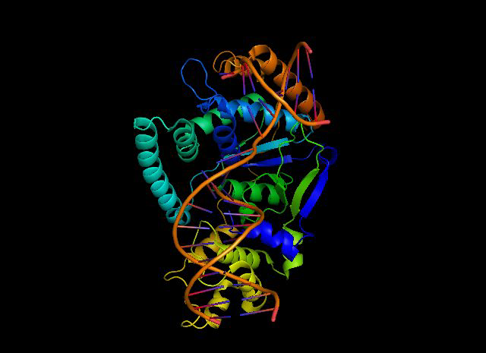
FEN1 (flap structure-specific endonuclease 1)

Slide 2
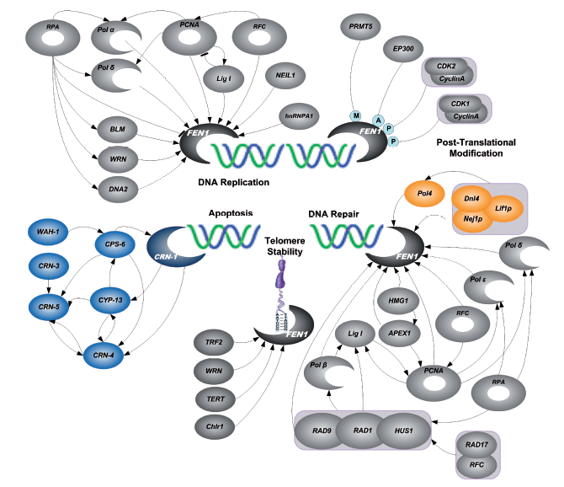
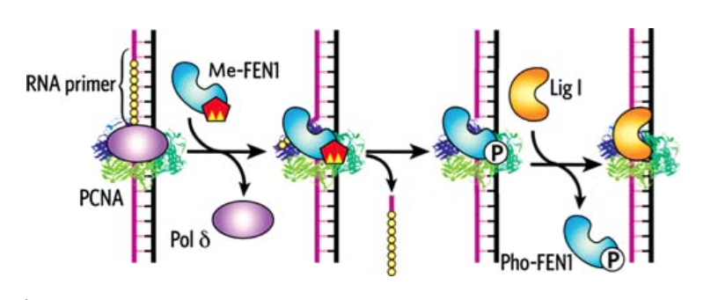
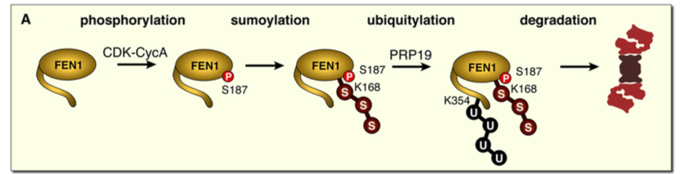
FEN1 (flap structure-specific endonuclease 1)
DNA replication-
Removal of the shorter/ longer
primer flap
DNA repair-
Base excision repair
Regulatory –
post-translation modification
Structure specific endonuclease:
recognize their substrates using a structure-based recognition mechanism, rather than a mechanism based on the chemical signatures of the constitute DNA bases.

Slide 3
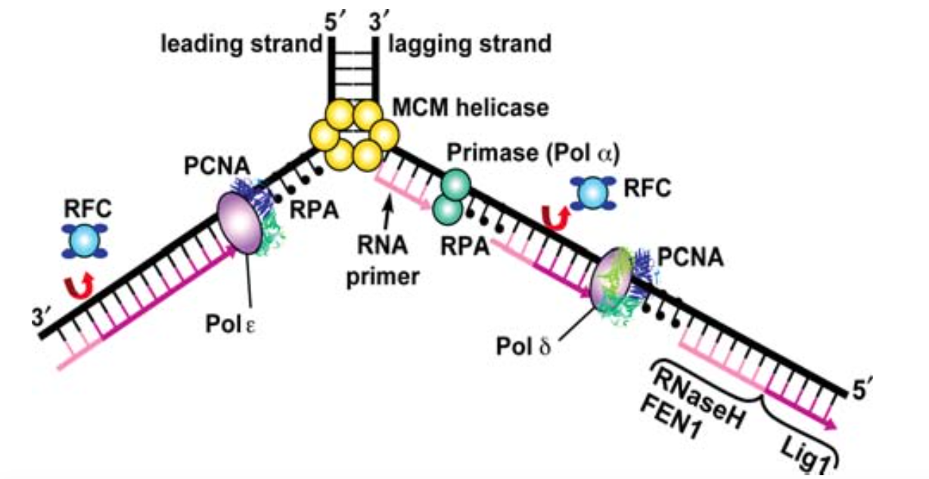
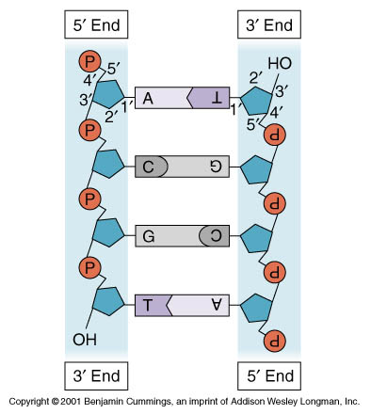
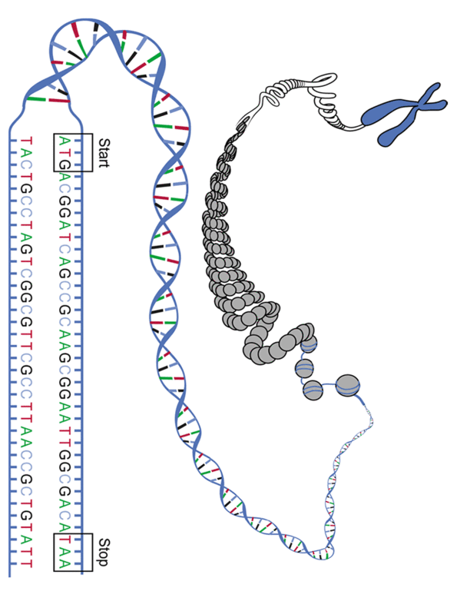
FEN1 (flap structure-specific endonuclease 1)
DNA replication- Removal of the shorter/ longer primer flap
Replication have directions, always 5’ to 3’
Highly coordinated process
Leading strand: 5’ -> 3’ , Primase -> Pol ε , synthesis the new strand continuousle
Lagging strand: 5’ -> 3’ , Primase/Pol alpha -> Pol σ/PCNA/RFC, synthesis a series of small new strand fragments (Okazaki fragment)
Notes:
Leading strand is synthesized continuously by pol from a single initiation event at the replication origin.
Lagging strand is initiated by the primase and is extended by pol sigma as a series of discrete okazaki fragments. The DNA Pol alpha/primase complex places frequent RNA primers, 7-14 nucleotides in length, on the lagging strand and elongates 10 to 20 nts, then Pol sigma/RFC/PCNA initiate synthesis and add 200 nts

Slide 4
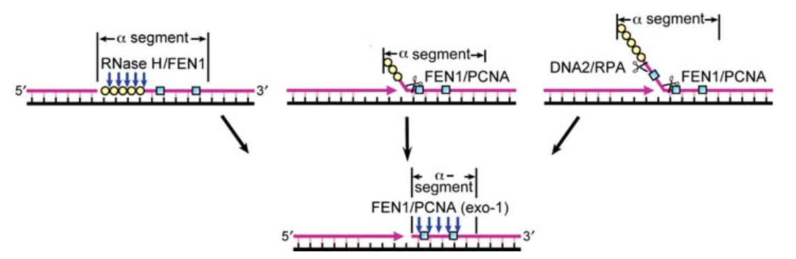
FEN1 (flap structure-specific endonuclease 1)
Why the primer need to be removed?
1.The flap
2.Primase doesn’t have the proofreading function.

Slide 5
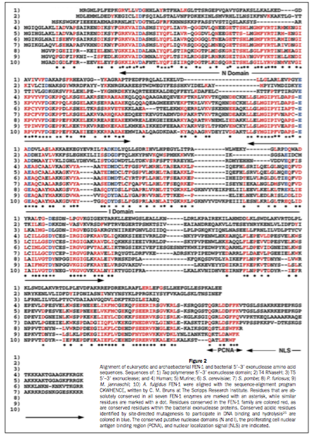
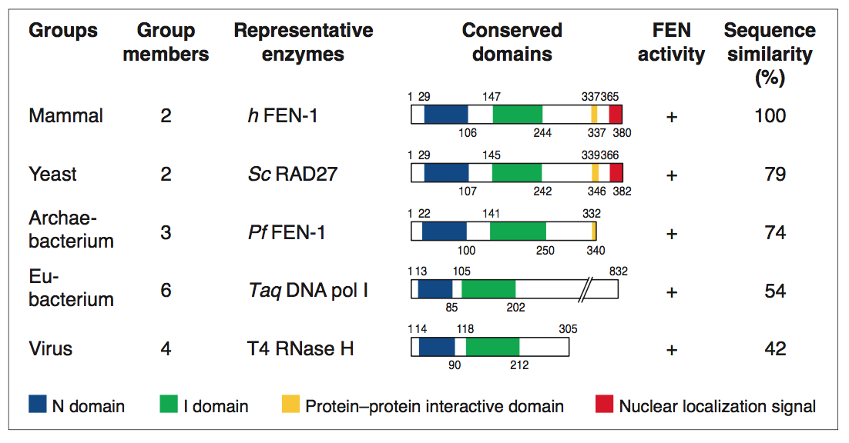
FEN1 (flap structure-specific endonuclease 1)
CONSERVED DOMAINS: N domain, I domain, C domain
N domain, I domain: Nuclease domain
C domain: Nuclear localization signal, protein-protein interaction site
(Find conserved amino acids by using site-directed mutagenesis )
Sequence similarity: Align Query ERRIE (EXpasy) (N, I domain)

Slide 6
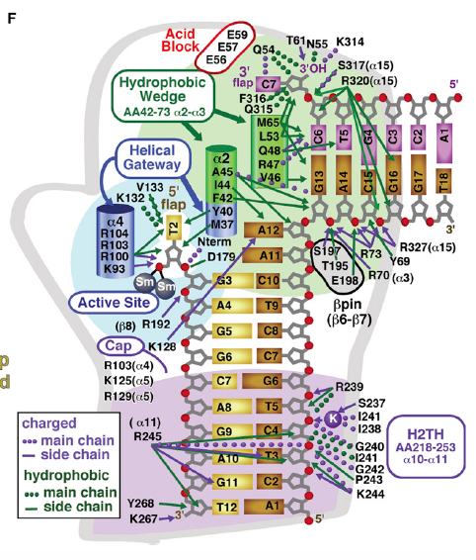
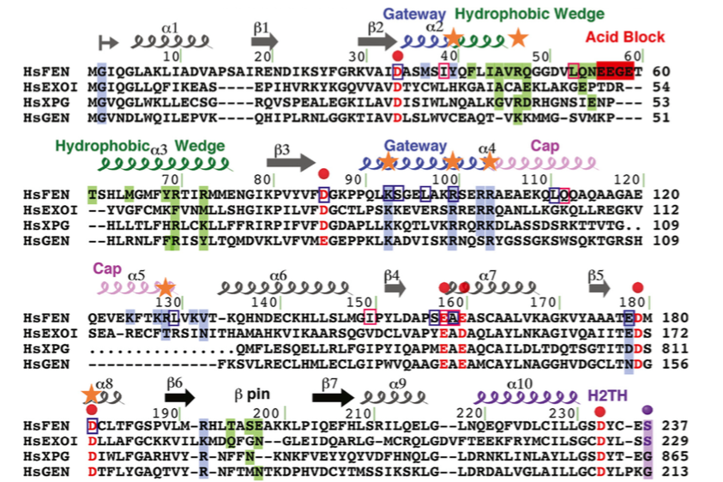
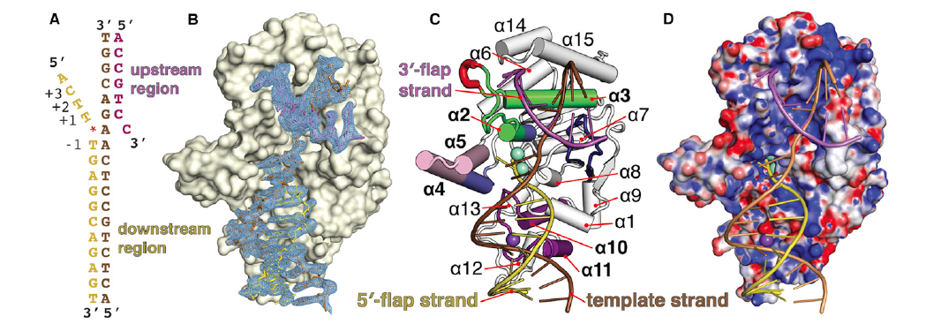
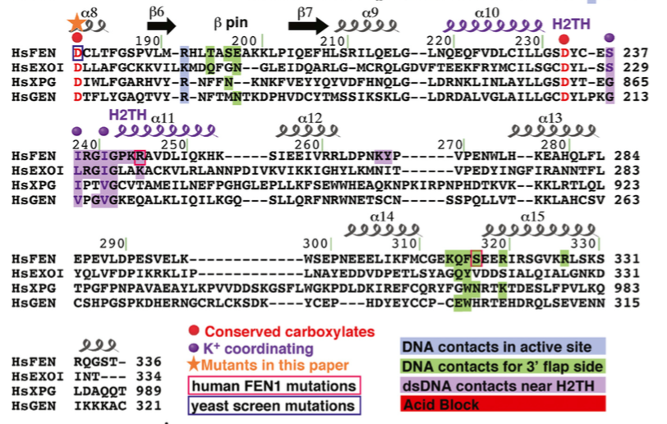
FEN1 (flap structure-specific endonuclease 1)
Use three substrate with FEN1 to determine FEN1:DNA structure determination and overall architecture
FEN1(1-336 aa) + substrate DNAs/product DNA
Palm Shape

Slide 7
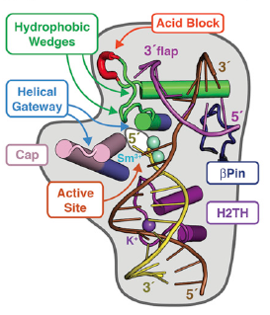
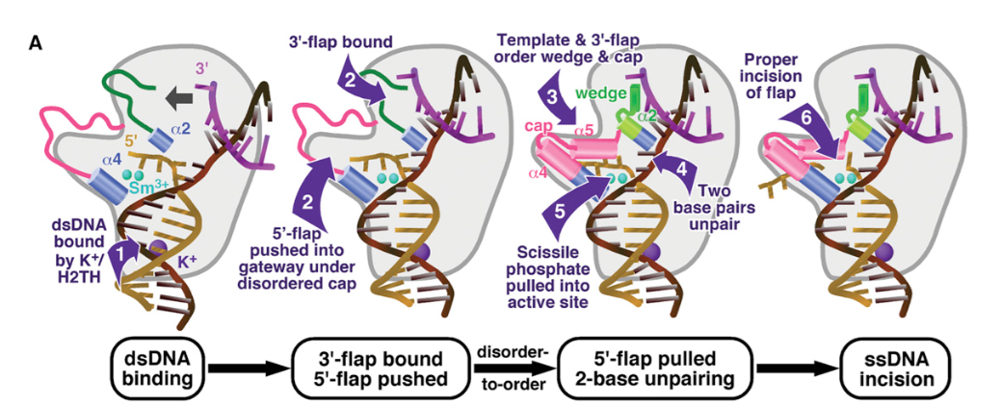
FEN1 (flap structure-specific endonuclease 1)
FEN1 must ensure incision takes place efficiently and specifically at the correct location needed to produce ligatable DNA.
Bind -> Bend -> Fray -> Cut
1. FEN1 recognize5 substrate(5’ flap) DNA by its ability to form a sharp 100 degree bend with dsDNA on either side.
2. A 3’ flap binding pocket encloses a single unpaired nt.
3.FEN1 requires the 5’ flap to pass under the cap to enter the helical gateway and active site.
4.FEN1 binds the template strand at the DNA bend and H2TH, thereby positioning the strand toward the active site.
5.The entrance to the FEN1 active site is guarded on two sides by the alpha 2-4 helical gateway.

Slide 8
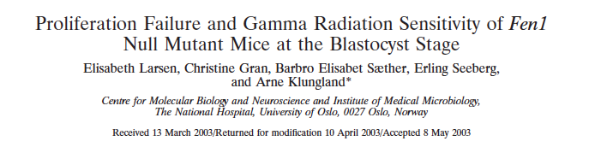
FEN1 (flap structure-specific endonuclease 1)
FEN1-related Disease
Insight

Slide 9
Thank you

Slide 10
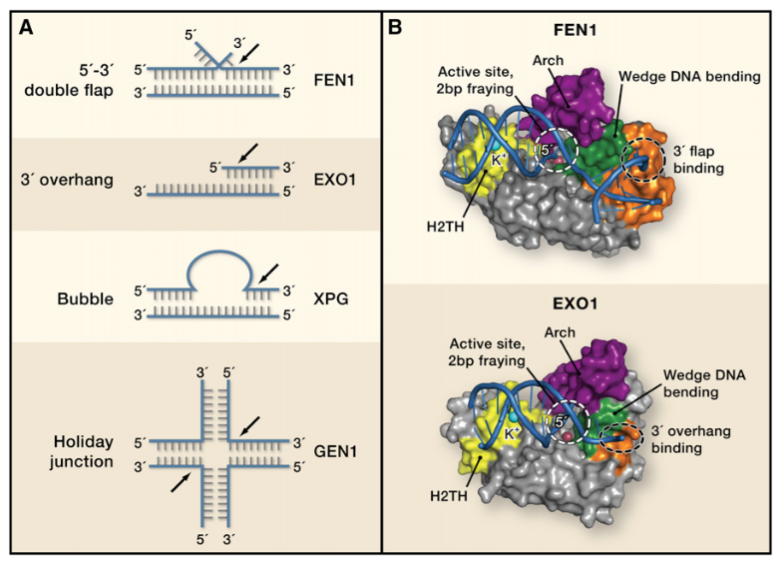
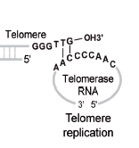
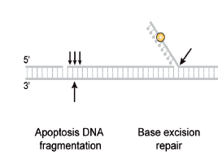
FEN1 (flap structure-specific endonuclease 1)
SUPPLEMENT S
DNA REPLICATION,
DNA REPAIR
TELOMERE

